Slide 1
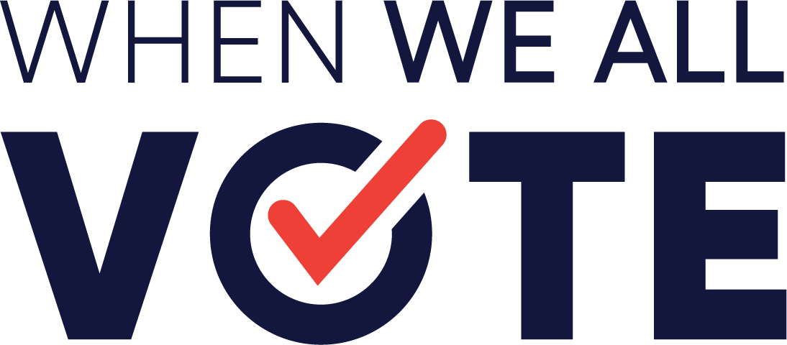
To change the culture around voting and to increase participation in each and every election by helping to close the race and age gap.
We aim to close the race and age gap and increase youth participation in each and every election by advancing civic education for the entire family and school community. In doing this, we will shift the culture around youth participation in our democracy.

Slide 2




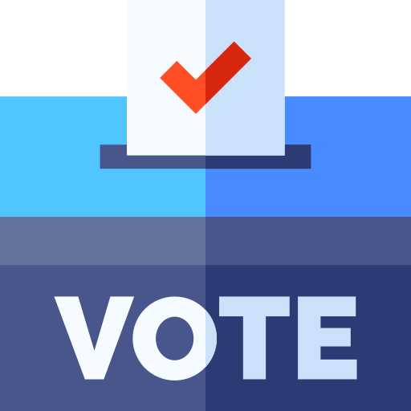
HOW DO WE DO IT?
Notes:
To schools across the country - esp partner networks in key states - we provide the tools, resources, guidance for students/teachers to organize, mobilize, and get their school registered and ready to vote

Slide 3
Deepening the work

Slide 4
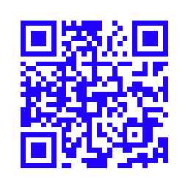
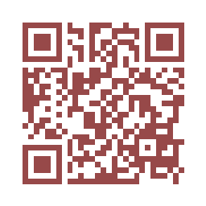
MSV Clubs: GOAL 400 by Nov 2022
Anchors work in a school
Long-term sustainability
Culture shifts
Register Your Club Here →
Civics 101 Training Program
Trainings once every month in campaign
skills
Each Training leads to an Action
Every Action, an opportunity to apply new skills to real work scenarios
https://whenweallvote.org/schools/civics101/
Check out resources Here →

Slide 5
Voter Registration: GOAL 50,000 by Nov 2022
Trainings, Toolkits and Guidance to support:
Season of Action VR Campaign - Kicking off March 16
Rites of Passage
Themed months (i.e. Women’s History Month)
Uncommon Club Goal:

Slide 6
Student Benefits
Community Service Hours
Civics Diplomas (in participating states)
Join a community of civic-oriented students

Slide 7
Spring Semester: 8-12 hrs/month student time
January 5 | February 2 | March 16
Connecting National Issues to the Local Level | Connecting Issues to Voting: Understanding your Student Body Student Surveys | Preparing for High School Voter Registration Season of Action Spring Season of Action Voter Reg Campaign Kickoff
April 6 | May 4 | June 1
Campaign Support MSV Ambassador Program Application Opens | Campaign Support College Forum | MSV Recognition Awards MSV Ambassador Program Selections Announced

